Slide 1
When the Bash Gets Flash

Slide 2
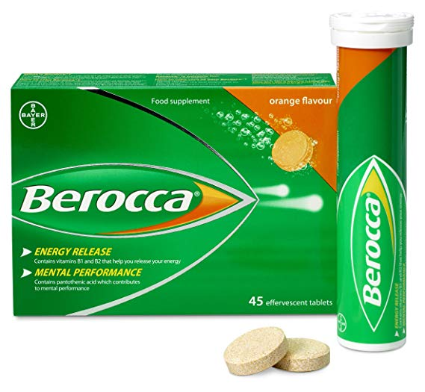

Shout out to couldn’t of done it without ya’s...
&

Slide 3
Background:
The reason programming caught my eye to begin with was because of its capabilities to create a positive impact in this world and help people.
While this app won't really help anyone in the real world, it’s a step towards that desire and a spark for the ideas engine.
With RUOK day around the corner i have themed my application around mental illness.

Slide 4
Purpose & Scope:
The application i created is essentially a Virtual Mental Health E-Kit.
The target audience is broad due to mental illness being a global problem.
However the user stories were written from the perspective of people who regularly attend a GP.

Slide 5
Purpose & Scope continued:
1st problem identified:
The problem identified was that self help can be hard when the user is feeling down in the dumps.
It is hard for them to think of healthy activities themselves when their in this state and don’t have a healthy perspective to do so themselves.
Solution:
Therefore the applications purpose is to improve the users mood via recommending a guide of science-backed healthy activities for them.

Slide 6
2nd problem identified:
It is sometimes hard for someone with a mental disorder to recall their moods accurately when their GP / Psychiatrist asks them these type of questions.
Solution:
Features such as a Mood Journal & Mood Chart were included so the user can help their GP give a more accurate diagnosis.
Charting their mood allows them and the GP to see patterns in their life."

Slide 7

Technical Challenges:
1st attempt at making a menu
case user_input #user-input value was defined above and passed into this case statement.
when 1
#functionality for 'Activity Guide' goes here.
puts "#{activity_guide}" #test-verified. #1: Will puts activity_guide
user_input = menu_prompt.select("Select an option", options)
#3:Collect new input value so that redirection is possible.
until user_input != 1 do
puts "You have already selected activity guide. Please choose another option.".colorize(:red)
puts
user_input = menu_prompt.select("Select an option", options)
end
case user_input #user-input value was defined above and passed into this case statement.
when 1
#functionality for 'Activity Guide' goes here.
puts "#{activity_guide}" #test-verified. #1: Will puts activity_guide

Slide 8

Technical Challenges:
1st attempt at making a menu
Technical Challenges:
2nd attempt at making a menu
class Menu
attr_reader :quit
def initialize(*menu_opt) #when ruby see's a splat it turns all the values into an array for me and eliminates the need to include all the menu
@menu_opt = menu_opt #array of strings (strings = menu options)
@quit = @menu_opt.length #setting the 'quit' option to menu.length will allow me to easily add features to the menu without having to change the value of quit as long as 'quit' has the same value as the menu item length.
end
def get_user_choice #needs to: 1.print out menu, 2.ask user for choice_value and 3.return value they chose.
# print menu
@menu_opt.each_with_index do |menu_item, index|
puts "#{index + 1}. #{menu_item}" #numbers menu-options/items.
end
#prompt user for choice
print "Enter your choice: "
user_choice = gets.to_i
puts #need this to insert line space between 'choice selection' & 'choice result/return' for aesthetic purposes.
#returns/outputs user_choice
return user_choice
end
end
menu = Menu.new( #rather then incorparating menu items/parameters in standard single line format i chose to sacrifice some bytes and use this option so that for someone reading the code, it can be easily distinguished as a menu.
"Launch Activity Guide.",
"View Progress.",
"Mental Health FAQ'S.",
"Quit MH-Kit." #after user inputs a menu-option it will display/return the choice they made via the puts strings i have included below in the case statement.
)

Slide 9


Slide 10
What i Learnt in the process?
-I need to slow down and ask myself questions until i have identified the root problem.
-There is loaaaaddssssss more i need to learn about writing semantic code.
-Most importantly it’s ok not to know.
-I’ll welcome any chance to improve my code and look forward to discussing what i could do better.

